Slide 1
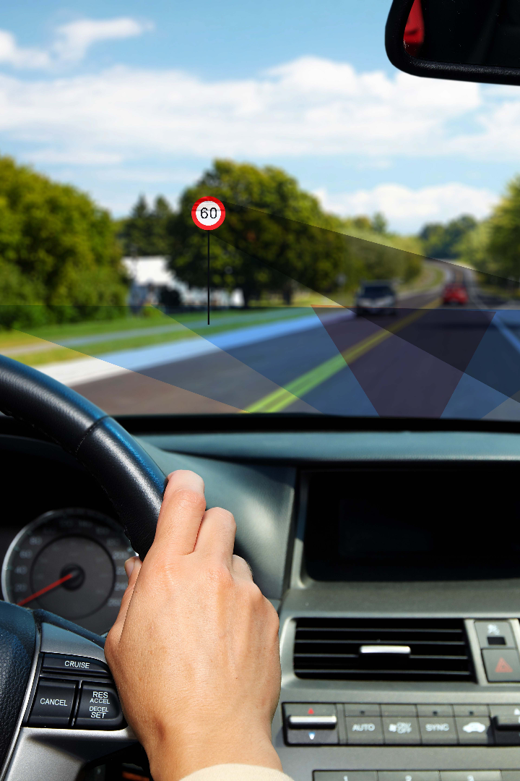


Traffic Sign Recognition
Ft. Hassan Mohammed
Sethuraja
Karthikeyan

Slide 2
Abstract
Traffic sign recognition (TSR) is a technology through which a vehicle can recognize the traffic signs on the road, such as "speed limit," "children," or "turn ahead." This is part of the features collectively called Advanced Driver Assistance Systems (ADAS). The technology is being developed by a variety of automotive suppliers and utilizes image processing techniques to detect traffic signs. The detection methods can be generally divided into color-based, shape-based, and learning-based methods.

Slide 3
Existing methods
Companies like Google, Tesla, Uber, Ford, Audi, Toyota, Mercedes-Benz, and many more are automating vehicles with enhanced technology.
When we go on the road, we see various traffic signs like traffic signals, turn left or right, speed limits, zebra crossing, u-turn, no passing of heavy vehicles, no entry, children crossing, etc., that we need to follow for safety purpose. Likewise, autonomous or self-driving cars must interpret these signboards and make decisions to achieve maximum accuracy. This algorithm recognizes which class a traffic signboard belongs to is called Traffic signs recognition
We will build a model for classifying traffic signs available in the image into many categories using CNN and Keras library.

Slide 4



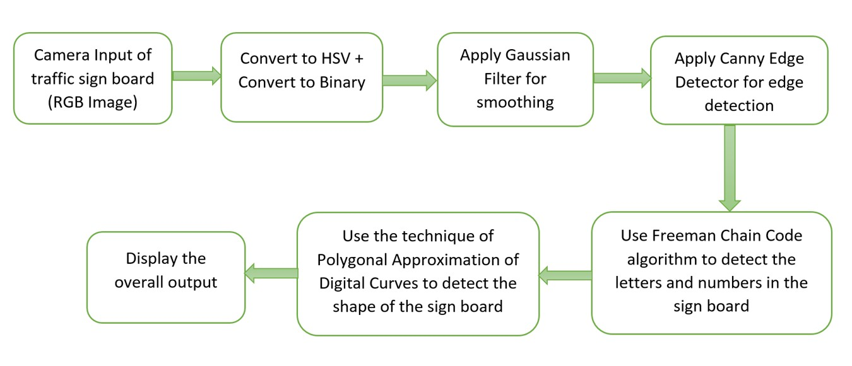
How Traffic Sign Recognition Works
Computer Vision
Neural Networks
Image Processing

Slide 5
Advantages
3
1
Real-time detection
2
Improved accuracy
3
Optimized navigation
Advanced algorithms enable real-time identification of traffic signs, allowing for quicker decision making.
Machine learning algorithms interpret and respond to traffic signs accurately, reducing the risk of accidents.
Integration with GPS data optimizes navigation and driver assistance systems for a safer and more efficient driving experience.

Slide 6
Challenges in Traffic Sign Recognition
1
Environmental Variability
2
Multilingual Signs
Challenges posed by varying lighting, weather, and environmental conditions.
Difficulty in recognizing and interpreting multilingual or non-standardized road signs.
3
Damage or Occlusion
4
Dynamic Scenes
Issues with recognizing signs that are damaged or partially obstructed.
Complexity introduced by sign visibility in dynamic traffic scenarios.

Slide 7
Proposed Methodology
Imagine driving with a virtual co-pilot who reads you the road! This innovative system uses a powerful camera to capture traffic signs in real-time. Artificial intelligence instantly recognizes and interprets these signs, transforming them into clear voice messages delivered directly to you. No more squinting or deciphering – hear critical information like stop signs, speed limits, lane changes, and even construction zones, all while keeping your eyes focused on the road. This customizable system can prioritize important alerts, integrate with GPS for location-specific warnings, and ultimately enhance your awareness and safety behind the wheel. Drive smarter, drive safer, with the power of talking traffic signs!

Slide 8
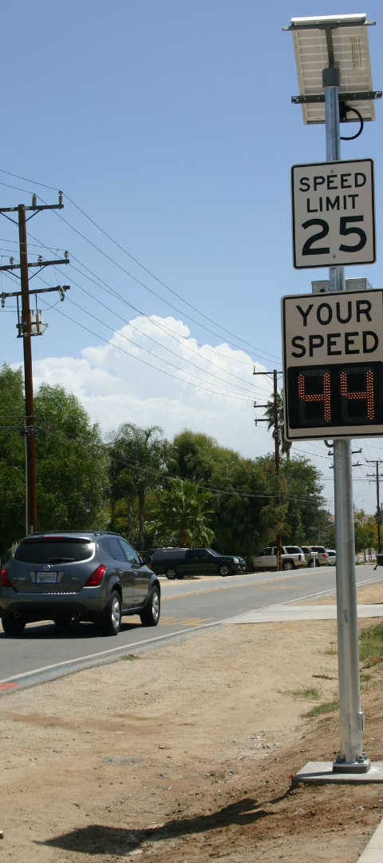
Applications of Traffic Sign Recognition
Autonomous Vehicles
Smart Cities
Enables autonomous vehicles to recognize and respond to traffic signs effectively.
Integrates with smart city infrastructure for traffic management and safety enhancement.
Driver Assistance
Facilitates driver assistance systems to provide real-time visual cues and alerts to the driver.

Slide 9
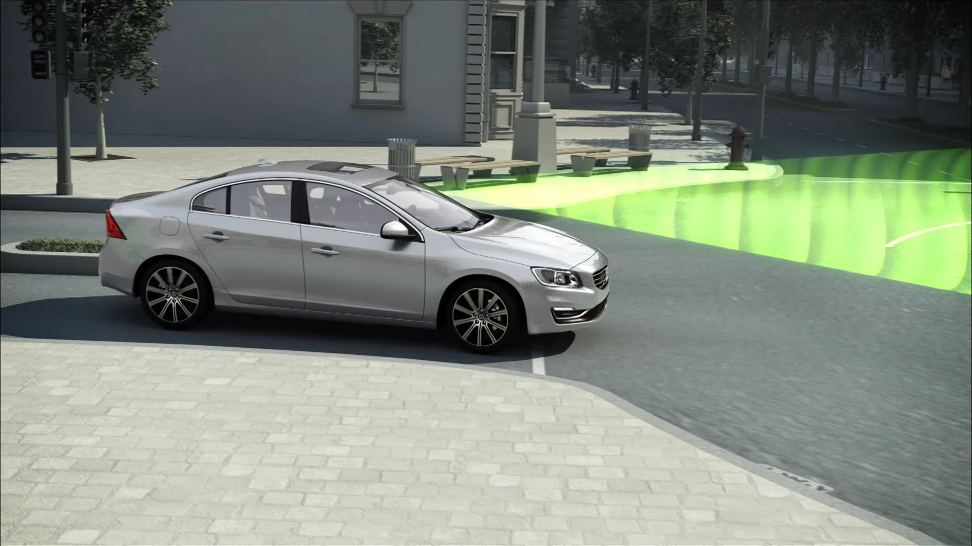

Slide 10
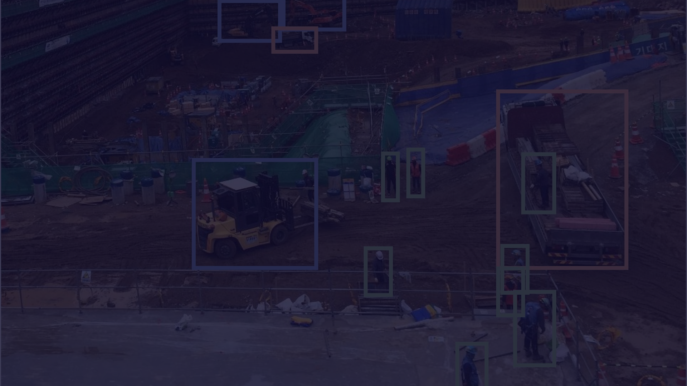



Conclusion
Enhanced Safety
Continual Innovation
Industry Integration
Leads to enhanced road safety and accident prevention through proactive sign recognition.
Promises continuous innovation in AI and advanced sensor technologies for superior recognition capabilities.
Will play a pivotal role in the integration of traffic sign recognition in diverse industries and domains.

Slide 11
https://media0.giphy.com/media/v1.Y2lkPTc5MGI3NjExbnF0NXR4OXpvNjc0ZWxhcmtzcXE4Z3d5OW5senM3MTFsZ2tzdHprNiZlcD12MV9pbnRlcm5hbF9naWZfYnlfaWQmY3Q9Zw/5r23ff6dhoGGJKoqq0/giphy.gif

